Slide 1





Project 3
Analysis of Top 500 Indian Cities
Copyright © Cognitior
www.cognitior.com

Slide 2
Dataset Information
Top 500 Indian Cities statistical indicators
Copyright © Cognitior
www.cognitior.com

Slide 3
Objective
The objective of the given project is to analyse the Top 500 Indian Cities dataset provided by the Indian Government and present answers in a visual manner
Copyright © Cognitior
www.cognitior.com

Slide 4
Important Inferences
to be made
1. Which states have highest population count?
2. Compare literacy across the states.
3. Top 10 cities with high literacy.
4. Explore sex ratio of different states.
5. Percentage of total Graduate against Total Population of States.
6. States with most cities in Top 500.
Copyright © Cognitior
www.cognitior.com

Slide 5
Problem Approach
The expected inferences were based directly on the dataset provided and demanded only the extraction of necessary information from the given dataset(s) by slicing and merging tables. Visualizations were made using matplotlib. (All total population values were scaled by 3)
Copyright © Cognitior
www.cognitior.com

Slide 6
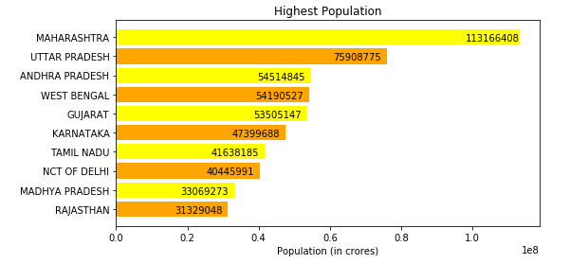
Important Inferences
Results
Which states have highest population count?
Copyright © Cognitior
www.cognitior.com

Slide 7
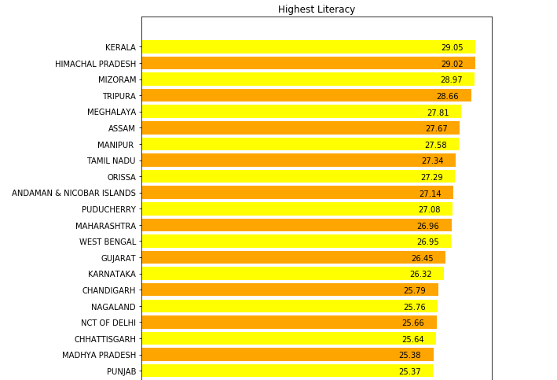
Important Inferences
Results
Comparison of literacy rates across the states.
Copyright © Cognitior
www.cognitior.com

Slide 8
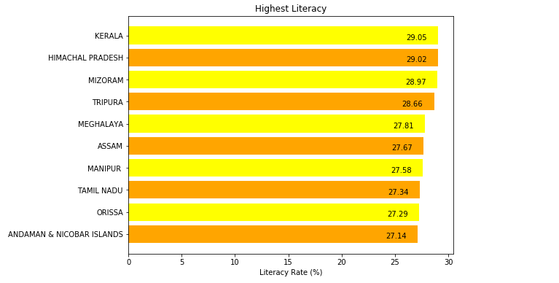
Important Inferences
Results
Top 10 cities with high literacy
Copyright © Cognitior
www.cognitior.com

Slide 9
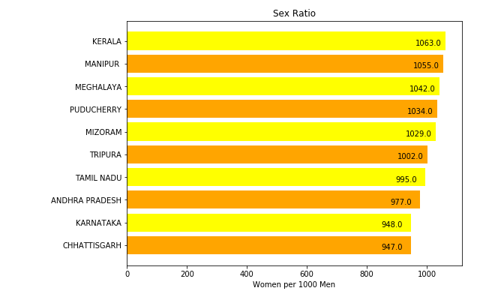
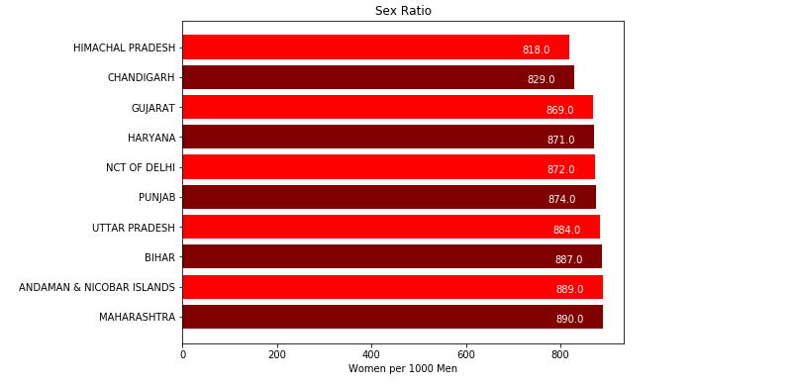
Important Inferences
Results
Explore sex ratio of different states
Top 10
Worst 10
Copyright © Cognitior
www.cognitior.com

Slide 10
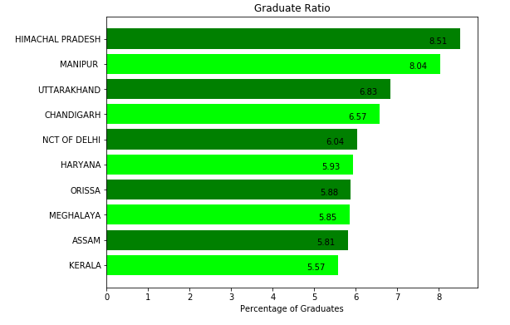
Important Inferences
Results
Percentage of total Graduate against Total Population of States
Copyright © Cognitior
www.cognitior.com

Slide 11
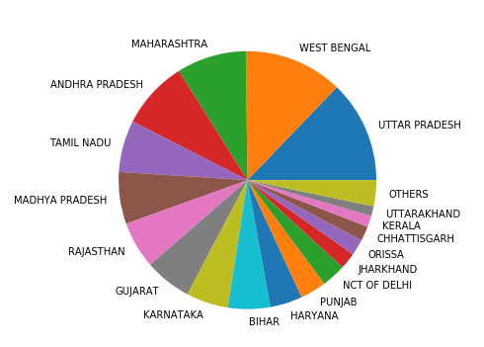
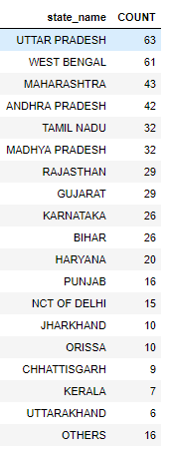
Important Inferences
Results
States with most cities in Top 500
Copyright © Cognitior
www.cognitior.com

Slide 12
Thank You!!!
Any Questions?
support@cognitior.com
Copyright © Cognitior
www.cognitior.com

